Slide 1
Applied Data Science
Motoric
Pascal Seegers (21132844)
Joost van viegen (18048757)
Lisa Dumaij (19049838)
Mustafa Mousa (18068987)
Joep van der Zanden (19134282)
Yuliya litvin (20161417)

Slide 2
Content
5 minutes presentation
Project meeting
Data exploration and preparation
Results
Goals

Slide 3

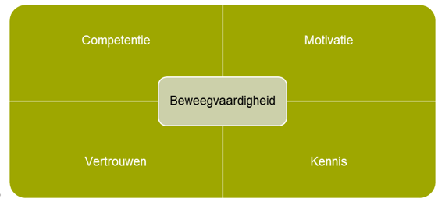
Project meeting
Motoric competence
Questionnaire
Create a profile of children who are motor incompetent

Slide 4
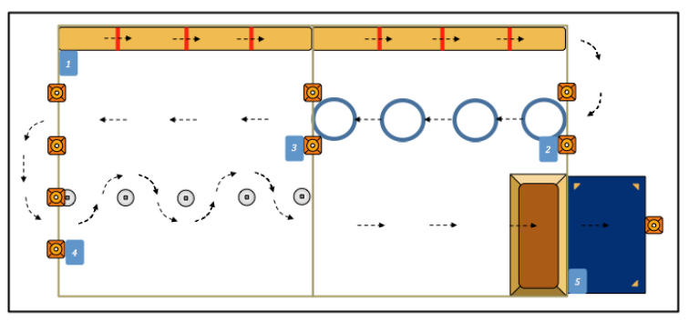
Competence
Notes:
150 procent meer

Slide 5
Motivation
Notes:
150 procent meer

Slide 6
Perception
Notes:
150 procent meer

Slide 7
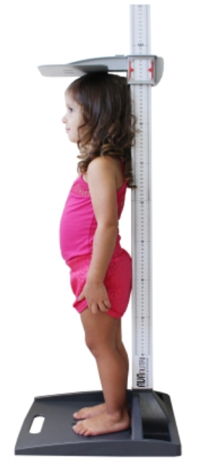
BMI
Notes:
150 procent meer

Slide 8
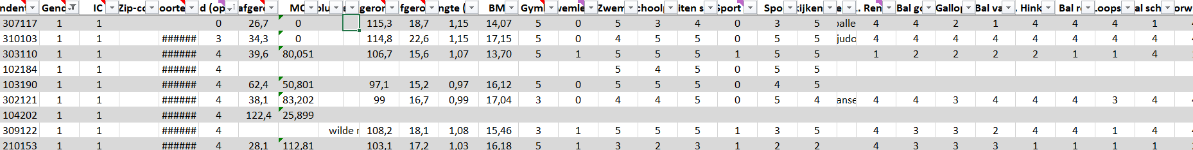
Data exploration and preparation
Notes:
5 year decreasing. 22% = 65 plus; 13,2 miljoen. Netherlands 18 %; 3 miljoen.

Slide 9
Data exploration and preparation
what time makes a child motor competent?
Zip codes
Notes:
5 year decreasing. 22% = 65 plus; 13,2 miljoen. Netherlands 18 %; 3 miljoen.

Slide 10
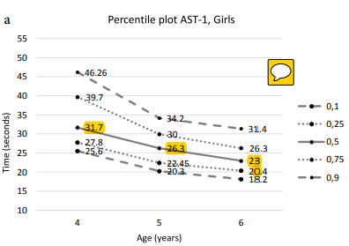
Results
MQ = (50th percentile AST-x/time AST-x) × 100.
Notes:
5 year decreasing. 22% = 65 plus; 13,2 miljoen. Netherlands 18 %; 3 miljoen.

Slide 11
Results
if (geslacht=0 and Leeftijdoptestdag >=5.0000 and Leeftijdoptestdag<=5.9999 and MQscore >0 and MQscore<=75) MQ_categorie =1.
if (geslacht=0 and Leeftijdoptestdag >=5.0000 and Leeftijdoptestdag<=5.9999 and MQscore >=76 and MQscore <=86) MQ_categorie =2.
if (geslacht=0 and Leeftijdoptestdag >=5.0000 and Leeftijdoptestdag<=5.9999 and MQscore >=87 and MQscore <=120) MQ_categorie =3.
if (geslacht=0 and Leeftijdoptestdag >=5.0000 and Leeftijdoptestdag<=5.9999 and MQscore >=121 and MQscore <=143) MQ_categorie =4.
if (geslacht=0 and Leeftijdoptestdag >=5.0000 and Leeftijdoptestdag<=5.9999 and MQscore >=144 and MQscore <=300) MQ_categorie =5.
Notes:
5 year decreasing. 22% = 65 plus; 13,2 miljoen. Netherlands 18 %; 3 miljoen.

Slide 12
Results
1 = severe motoric incompetence
2 = minor motoric incompetence
3 = average motoric competence
4 = good motoric competence
5 = Excellent motoric competence
Notes:
5 year decreasing. 22% = 65 plus; 13,2 miljoen. Netherlands 18 %; 3 miljoen.

Slide 13
Goals
Data imputation
Add CBS statistics to the dataset
Devise a way to add the answers from the questionnaires to the dataset
Create a profile of children who are motor incompetent
Notes:
5 year decreasing. 22% = 65 plus; 13,2 miljoen. Netherlands 18 %; 3 miljoen.

